Slide 1
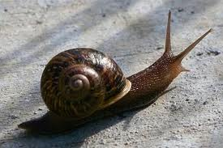
Invertebrates
“An inordinate fondness for beetles”
- J.B.S. Haldane

Slide 2
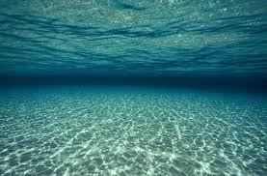
Kingdom: Animalia
There are two major groups of animals in Kingdom Animalia:
vertebrates (Chordata) and
invertebrates .
Vertebrate is another word for backbone, so a vertebrate animal has a backbone, and an invertebrate animal does not. People are vertebrates, worms are not.

Slide 3
There are a lot of invertebrates
Of the more than 2 million animals world wide, 97% are invertebrates.

Slide 4
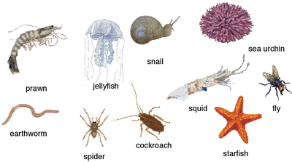
There are 8 major groups of invertebrates

Slide 5
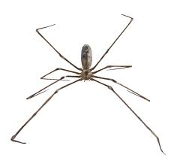
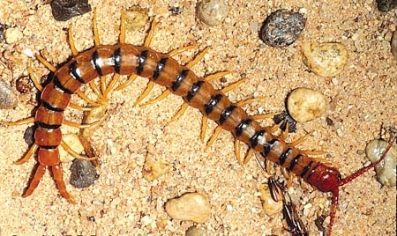
Arthropods
Without a doubt, the largest group of animals on the planet
¾ of ALL animal species are arthropods
Here are their Major Characteristics:

Slide 6
Arthropds
Exoskeleton
Jointed legs
Bodies with segments
EXAMPLES: Insects, Arachnids, Crustaceans

Slide 7
Sponges
Sponges are the simplest invertebrates
They don’t have complex bodies at all, there are no organs, no nervous system, no blood

Slide 8
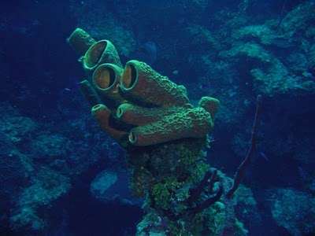

Slide 9
Cnidariens
The Cnidariens (Ni-dare-ee-ans) are the jellyfish, corals, and sea anemones.
They have radial symmetry, tentacles, and stingers

Slide 10
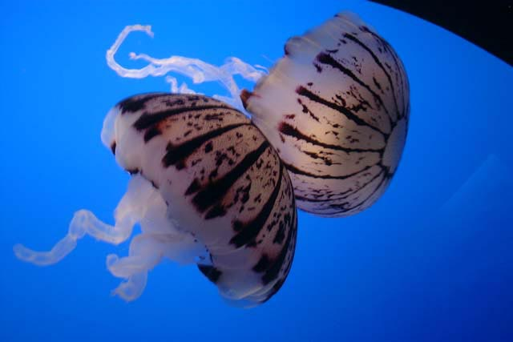

Slide 11
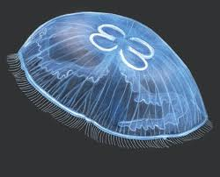

Slide 12
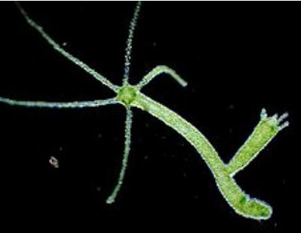

Slide 13
Annelid Worms
Annelids are the segmented worms
Includes earthworms, leeches, and sea worms
They have:
segmented bodies
long guts
tube shape

Slide 14
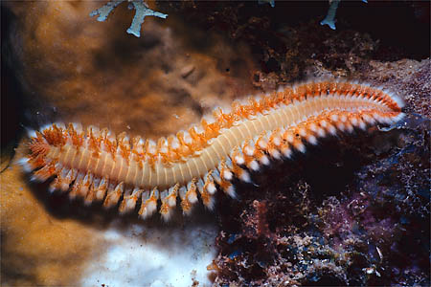
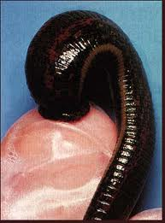
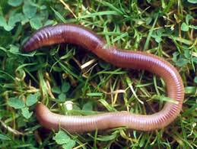

Slide 15
Molusk
Molusks are a big, WEIRD group
Very diverse
Includes :
Squid and octopi
Slugs
Snails
Oysters and clams

Slide 16
Molusks
All mollusks have:
A special tongue with a tooth on it
Gills hidden by a protective muscle-ey “Mantel”
A protective shell – sometimes this has shrunk to almost nothing. Like in octopi and slugs

Slide 17
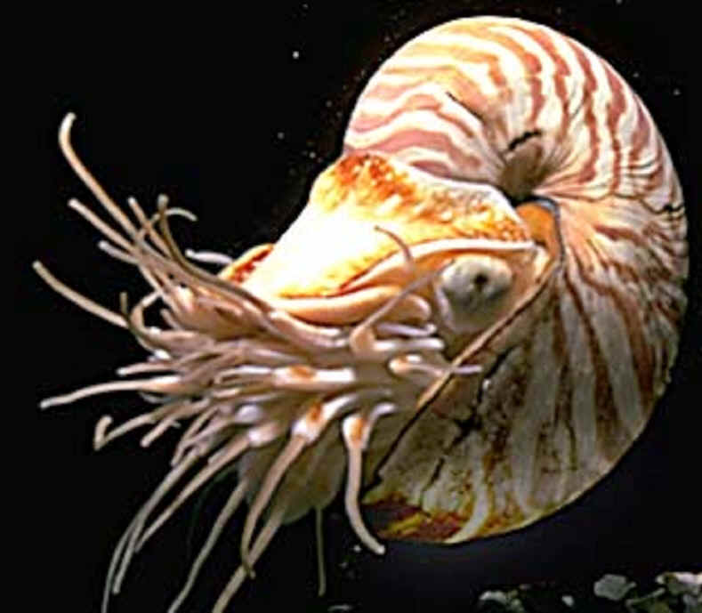

Slide 18
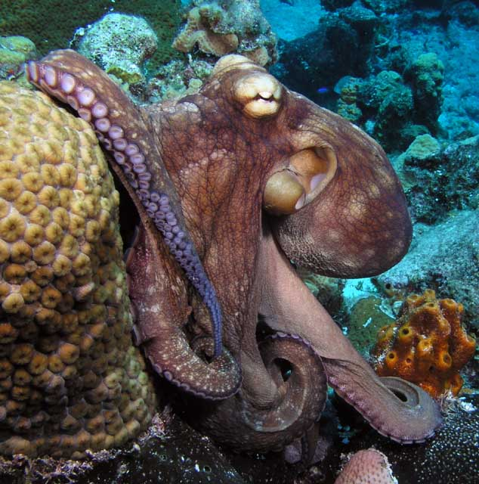
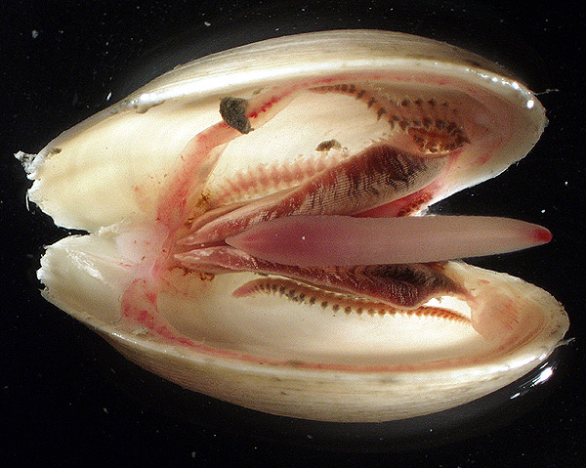

Slide 19
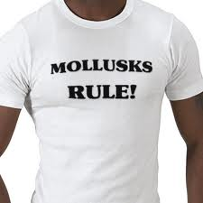

Slide 20
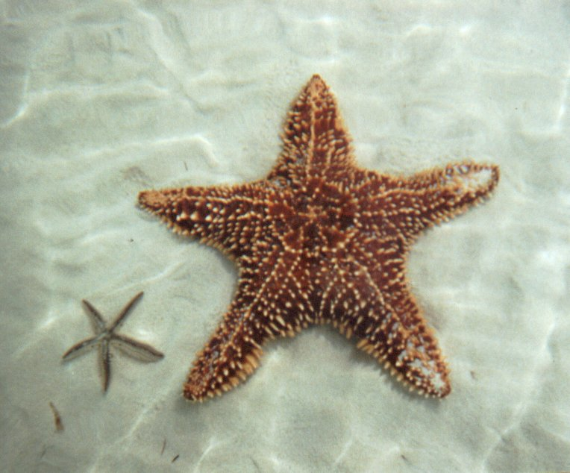
Echinoderms
starfish, sea urchins, sea cucumbers, sand dollars

Slide 21
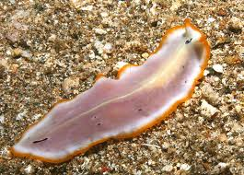
Flatworm

Slide 22
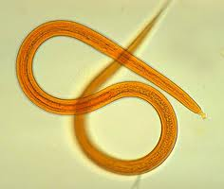
Roundworm

